Slide 1

Acumed: Introduction
Name:
Date

Slide 2
How to Use
Slides 3–15 include optional, preapproved “About Acumed” content designed to convey a strong message about our company values and offerings. These can be used as-is, removed, or reinserted at any time.
Slides 17–32 offer a variety of layout options for your main content—and all “About Acumed” slides are also available in the layout menu. To access any layout, right-click on a slide, select Layout, and choose from the available designs.
This flexible format helps you build clear, professional presentations while maintaining brand consistency.

Slide 3
Agenda
Our Story
Who We Are
Mission/Vision/Values
Foundations of Excellence
Key Differentiators
Product Portfolio
[optional] Products Section

Slide 15
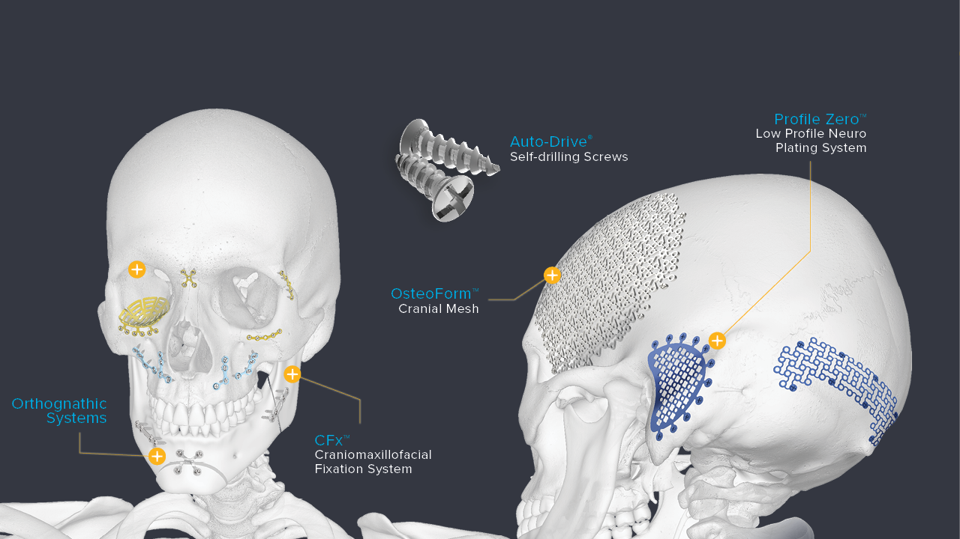

Craniomaxillofacial & Neurosurgical

